Slide 1
L7 Imitation Learning II
Z. Gu 2020

Slide 2
Imitation Learning (IL)
IL is useful when it is easier for an expert to demonstrate the desired behavior, rather than to specify a reward function for RL to learn the policy.
e.g., for Automated Driving in a realistic environment, the reward function would be a huge complex function involving everything in the environment
Requires access to an expert, either offline (driving data logs) or online (query-on-demand)
Also called Learning from Demonstrations.
IL variants:
Learn to mimic the expert’s policy
Behavior Cloning
Direct Policy Learning
Learn the expert’s value function
Inverse Reinforced Learning

Slide 3
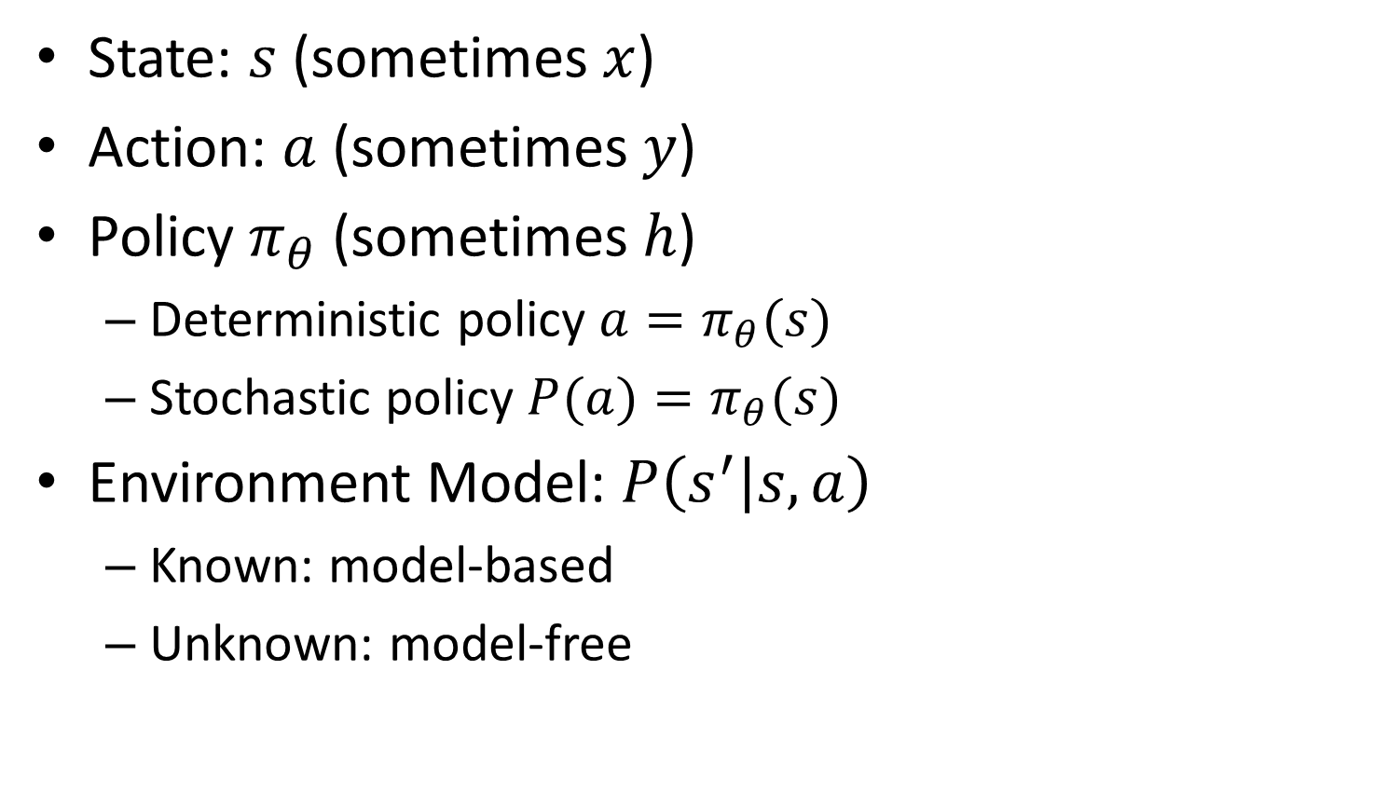
Notations
State: $s$ (sometimes $x$)
Action: $a$ (sometimes $y$)
Policy $π_{θ}$ (sometimes $h$)
Deterministic policy $a=π_{θ}(s)$
Stochastic policy $P(a)=π_{θ}(s)$
Environment Model: $P\left(s^{′} | s,a\right)$
Known: model-based
Unknown: model-free

Slide 4
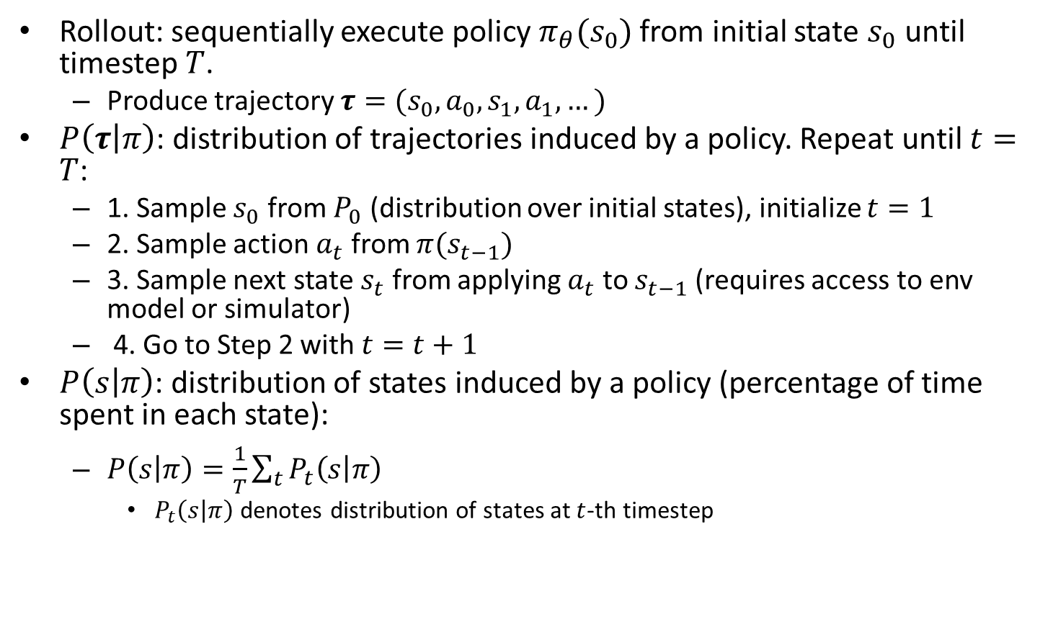
Notations Cont’d
Rollout: sequentially execute policy $π_{θ}(s_{0})$ from initial state $s_{0}$ until timestep $T$.
Produce trajectory $τ=(s_{0},a_{0},s_{1},a_{1},…)$
$P\left(τ | π\right)$: distribution of trajectories induced by a policy. Repeat until $t=T$:
1. Sample $s_{0}$ from $P_{0}$ (distribution over initial states), initialize $t=1$
2. Sample action $a_{t}$ from $π(s_{t−1})$
3. Sample next state $s_{t}$ from applying $a_{t}$ to $s_{t−1}$ (requires access to env model or simulator)
4. Go to Step 2 with $t=t+1$
$P\left(s | π\right)$: distribution of states induced by a policy (percentage of time spent in each state):
$P\left(s | π\right)=\frac{1}{T}\sum_{t}{P_{t}\left(s | π\right)}$
$P_{t}\left(s | π\right)$ denotes distribution of states at $t$-th timestep

Slide 5
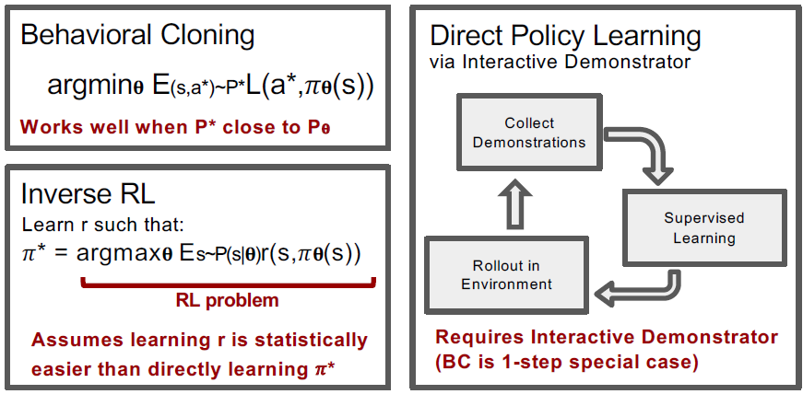
 | Learn Policy Directly | Learn Reward Function | Access to Env. | Interaction Demos | Pre-collected demos
BC | Y | N | N | N | Y
DPL | Y | N | Y | Y | Optional
IRL | N | Y | Y | N | Y
Notes:
Direct Policy
Learning
Reward
Learning
Access to
Environment
Interactive
Demonstrator
Pre-collected
Demonstrations

Slide 6
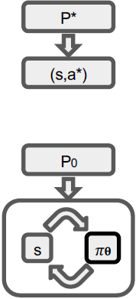
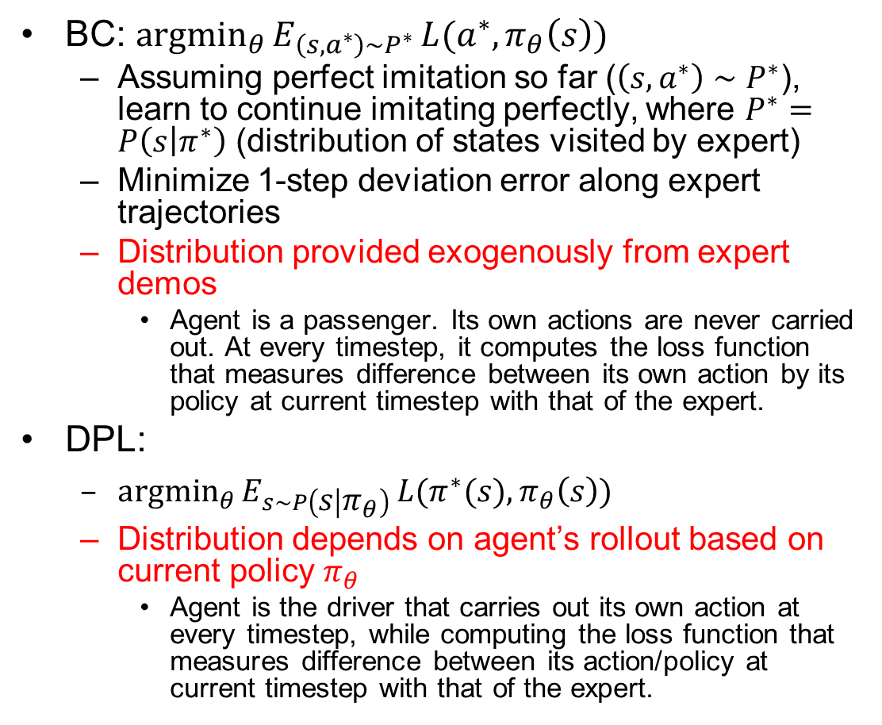
BC vs. DPL
BC: ${argmin}_{θ}{E_{\left(s,a^{∗}\right)∼P^{∗}}}L(a^{∗},π_{θ}\left(s\right))$
Assuming perfect imitation so far ($\left(s,a^{∗}\right)∼P^{∗}$), learn to continue imitating perfectly, where $P^{∗}=P\left(s | π^{∗}\right)$ (distribution of states visited by expert)
Minimize 1-step deviation error along expert trajectories
Distribution provided exogenously from expert demos
Agent is a passenger. Its own actions are never carried out. At every timestep, it computes the loss function that measures difference between its own action by its policy at current timestep with that of the expert.
DPL:
${argmin}_{θ}{E_{s∼P\left(s | π_{θ}\right)}}L(π^{∗}(s),π_{θ}\left(s\right))$
Distribution depends on agent’s rollout based on current policy $π_{θ}$
Agent is the driver that carries out its own action at every timestep, while computing the loss function that measures difference between its action/policy at current timestep with that of the expert.
Notes:
BC is off-policy learner (Q-learning) learns the value of the optimal policy independently of the agent's actions.
An on-policy learner learns the value of the policy being carried out by the agent including the exploration steps

Slide 7

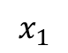
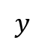
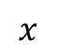
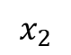
Supervised Learning: Classification and Regression
Classification is used to predict/classify discrete labels such as Male or Female, True or False, Spam or Not Spam, etc.
Regression is used to predict continuous values such as price, salary, age, etc.
Both are Supervised Learning algorithms that require ground-truth values as labels.
Both need loss functions to measure how the predicted value differs from ground-truth value.
$$x_{2}$$
Cat vs. Dog
$$y$$
$$x_{1}$$
$$x$$
https://www.javatpoint.com/regression-vs-classification-in-machine-learning

Slide 8
Loss Functions
Classification
Cross-Entropy Loss, Log Loss, Focal Loss, Exponential Loss, Hinge Loss…
Regression
MSE (Mean Squared Error)/L2 Loss/Quadratic Loss, MAE (Mean Absolute Error)/L1 Loss, Huber Loss, Log Cosh Loss, Quantile Loss…
https://heartbeat.fritz.ai/5-regression-loss-functions-all-machine-learners-should-know-4fb140e9d4b0

Slide 9
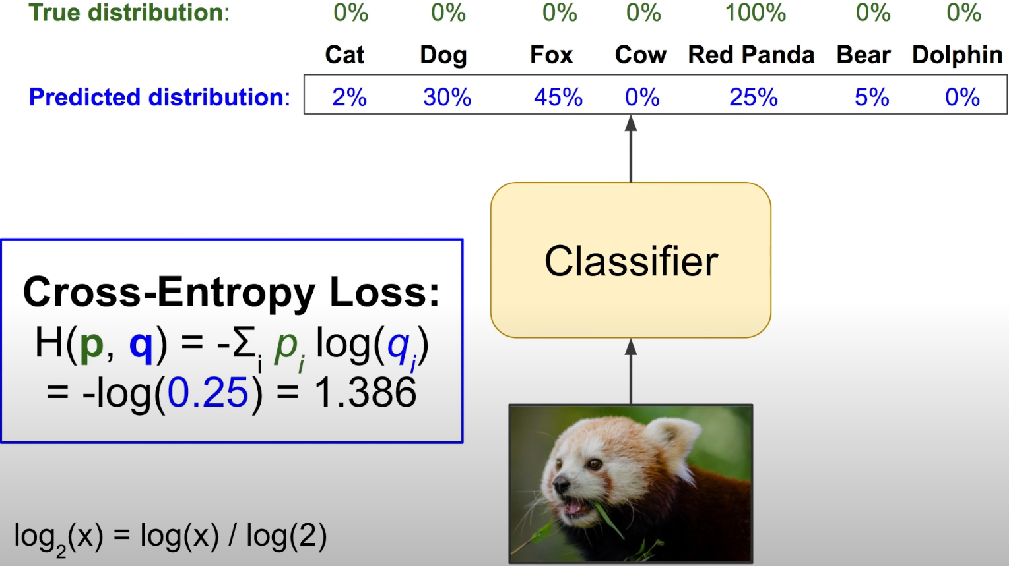
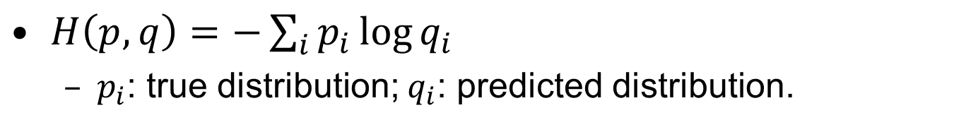
Classification: Cross-Entropy Loss
$H\left(p,q\right)=−\sum_{i}{p_{i}\log{q_{i}}}$
$p_{i}$: true distribution; $q_{i}$: predicted distribution.
Aurélien Géron A Short Introduction to Entropy, Cross-Entropy and KL-Divergence

Slide 10
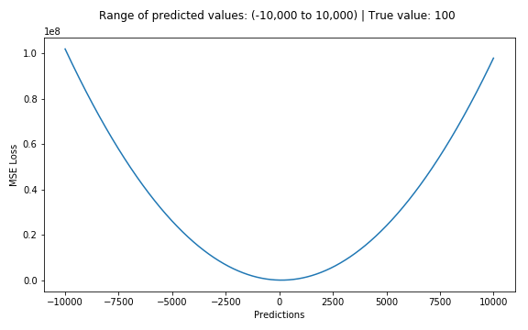
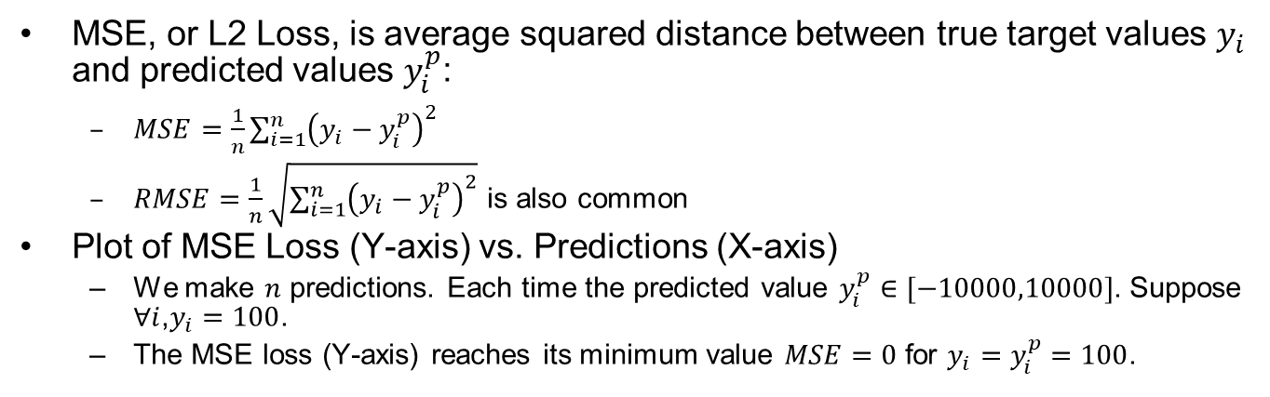
Regression: MSE/L2 Loss
MSE, or L2 Loss, is average squared distance between true target values $y_{i}$ and predicted values $y_{i}^{p}$:
$MSE=\frac{1}{n}\sum_{i=1}^{n}{{\left(y_{i}−y_{i}^{p}\right)}^{2}}$
$RMSE=\frac{1}{n}\sqrt{\sum_{i=1}^{n}{{\left(y_{i}−y_{i}^{p}\right)}^{2}}}$ is also common
Plot of MSE Loss (Y-axis) vs. Predictions (X-axis)
We make $n$ predictions. Each time the predicted value $y_{i}^{p}∈[−10000,10000]$. Suppose $∀i$,$y_{i}=100$.
The MSE loss (Y-axis) reaches its minimum value $MSE=0$ for $y_{i}=y_{i}^{p}=100$.
Notes:
$MSE=0$ for $y_{i}=y_{i}^{p}=100$; $0<MSE<∞$ otherwise.

Slide 11
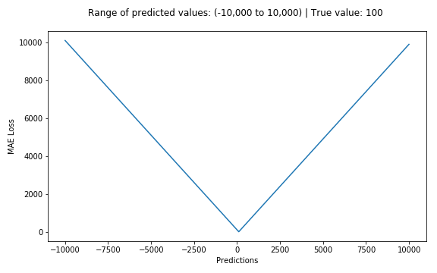
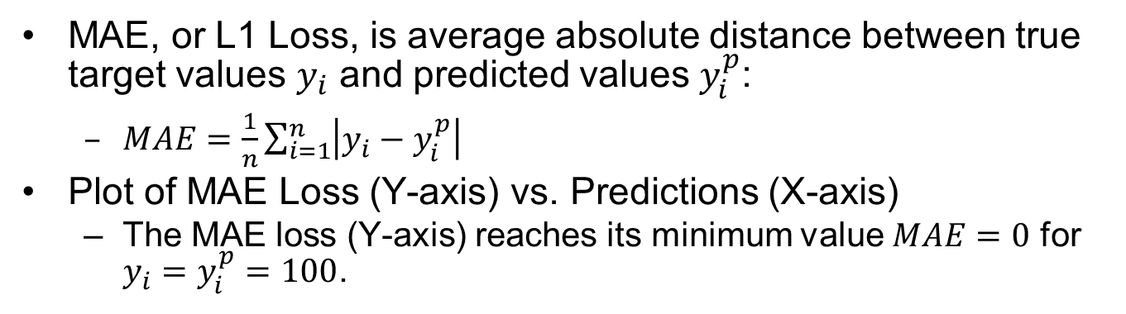
Regression: MAE/L1 Loss
MAE, or L1 Loss, is average absolute distance between true target values $y_{i}$ and predicted values $y_{i}^{p}$:
$MAE=\frac{1}{n}\sum_{i=1}^{n}{\left|y_{i}−y_{i}^{p}\right|}$
Plot of MAE Loss (Y-axis) vs. Predictions (X-axis)
The MAE loss (Y-axis) reaches its minimum value $MAE=0$ for $y_{i}=y_{i}^{p}=100$.

Slide 12
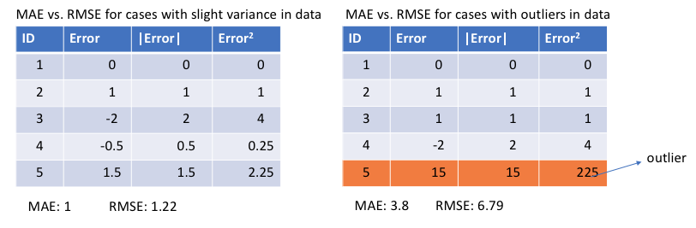
L1 vs. L2 Loss
L1 loss is more robust to outliers, but its derivatives are not continuous, making it inefficient to find the solution. L2 loss is sensitive to outliers, but gives a more stable and closed form solution (by setting its derivative to 0.)
Left: Errors are close to each other
Right: One outlier has huge error compared to others

Slide 13
[Zhou 2019]
Zhou, Brady, Philipp Krähenbühl, and Vladlen Koltun. "Does computer vision matter for action?." arXiv preprint arXiv:1905.12887 (2019). (Intel Labs, UT Austin)

Slide 14
Computer Vision vs. End-to-End
Computer vision tasks as perception module
Object recognition, depth estimation, optical flow, semantic segmentation…
e.g., train a model (CNN or others) with a large dataset to classify Stop Signs from images.
End-to-end approach
Map input images (raw pixels) directly to action, bypassing explicit computer vision tasks. Perceptual capabilities will arise as needed, as a result of training for the specific task.
e.g., if the training dataset is highway driving, then E2E model will never learn features of Stop Signs;
If the training dataset is urbane driving, then E2E model may learn features of Stop Signs implicitly in the intermediate layers of a CNN, during the process of learning the mapping from “Stop Sign” input images to “braking” action. But there is no explicit classification layer that outputs the label “StopSign”.
We report controlled experiments that assess whether specific vision capabilities are useful in mobile sensorimotor systems.
Does Computer Vision Matter for Action?
https://www.youtube.com/watch?v=4MfWa2yZ0Jc
Notes:
that act in complex 3D environments

Slide 15
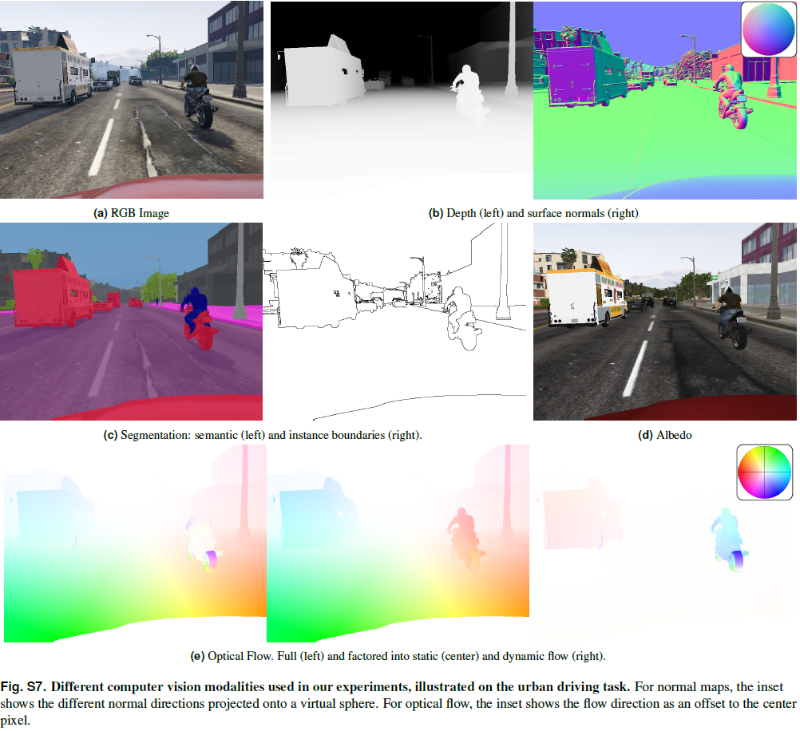

Slide 16
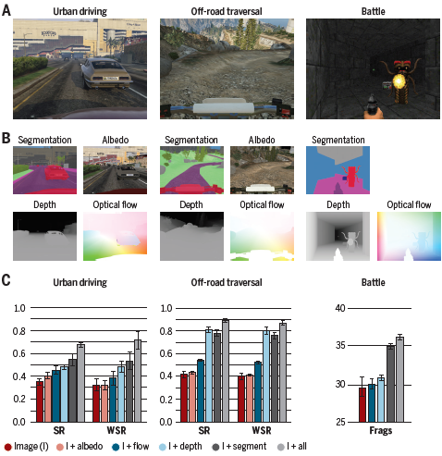
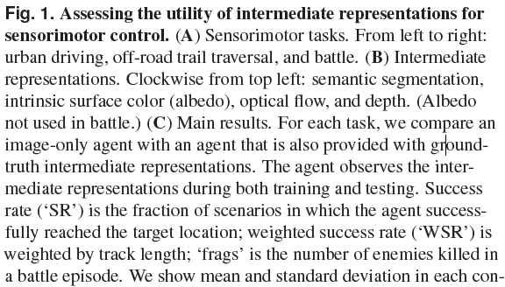
Performance Evaluation Results
Notes:
Surface albedo is defined as the ratio of radiosity to the irradiance (flux per unit area) received by a surface

Slide 17
Conclusions
Computer vision does matter.
When agents are provided with representations studied in computer vision, they achieve higher performance in sensorimotor tasks.
Some computer vision capabilities appear to be more impactful for mobile sensorimotor operation than others. Specifically, depth estimation and semantic segmentation provide the highest boost in task performance.
My thoughts: this explains rising popularity of mid-to-mid over end-to-end approaches.
Notes:
scene

Slide 18
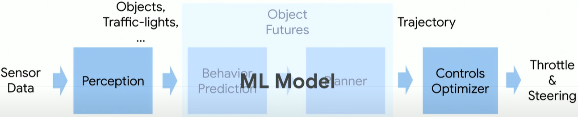
[Müller 2018]
Müller, Matthias, et al. "Driving policy transfer via modularity and abstraction." arXiv preprint arXiv:1804.09364 (2018). (KAUST, Intel Labs)
Mid-to-Mid

Slide 19
Abstract
End-to-end approaches to autonomous driving have high sample complexity and are difficult to scale to realistic urban driving. Simulation can help end-to-end driving systems by providing a cheap, safe, and diverse training environment. Yet training driving policies in simulation brings up the problem of transferring such policies to the real world. We present an approach to transferring driving policies from simulation to reality via modularity and abstraction. Our approach is inspired by classic driving systems and aims to combine the benefits of modular architectures and end-to-end deep learning approaches. The key idea is to encapsulate the driving policy such that it is not directly exposed to raw perceptual input or low-level vehicle dynamics. We evaluate the presented approach in simulated urban environments and in the real world. In particular, we transfer a driving policy trained in simulation to a 1/5-scale robotic truck that is deployed in a variety of conditions, with no finetuning, on two continents.

Slide 20
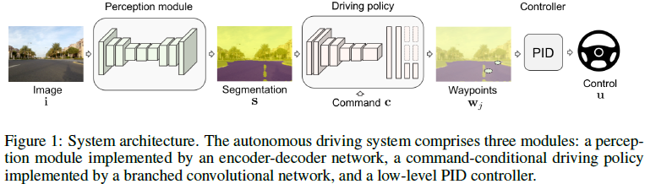
Modular Architecture
The perception module takes as input a raw RGB image and outputs a segmentation map.
The driving policy then takes this segmentation as input and produces waypoints indicating the desired local trajectory of the vehicle.
The low-level controller, given the waypoints, generates the controls: steering angle and throttle.
Driving Policy Transfer via Modularity and Abstraction
https://www.youtube.com/watch?v=BrMDJqI6H5U

Slide 21
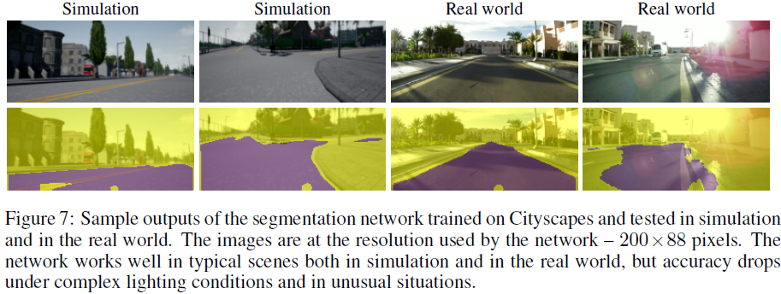
Perception Module for Image Segmentation
We use a per-pixel binary segmentation of the image into “road” and “not road” regions. It abstracts away texture, lighting, shading, and weather, leaving only a few factors of variation: the geometry of the road, the camera pose, and the shape of objects occluding the road. Such segmentation contains sufficient information for following the road and taking turns, but it is abstract enough to support transfer.
Generalization to new environments (e.g., different weather, country, etc.) or transfer to new domains (e.g., simulation to physical world) can be achieved by appropriately tuning the perception module.

Slide 22
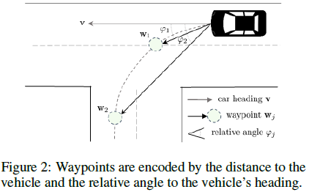
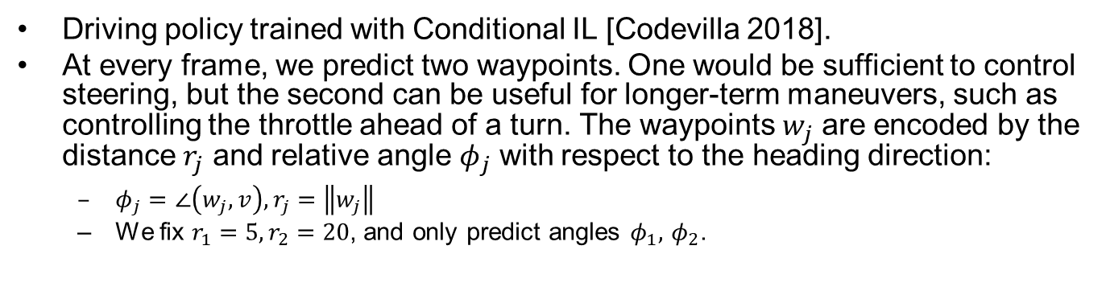
Driving Policy Module
Driving policy trained with Conditional IL [Codevilla 2018].
At every frame, we predict two waypoints. One would be sufficient to control steering, but the second can be useful for longer-term maneuvers, such as controlling the throttle ahead of a turn. The waypoints $w_{j}$ are encoded by the distance $r_{j}$ and relative angle $φ_{j}$ with respect to the heading direction:
$φ_{j}=∠\left(w_{j},v\right),r_{j}=\left\|w_{j}\right\|$
We fix $r_{1}=5,r_{2}=20$, and only predict angles $φ_{1},$ $φ_{2}$.
Notes:
Trajectory

Slide 23
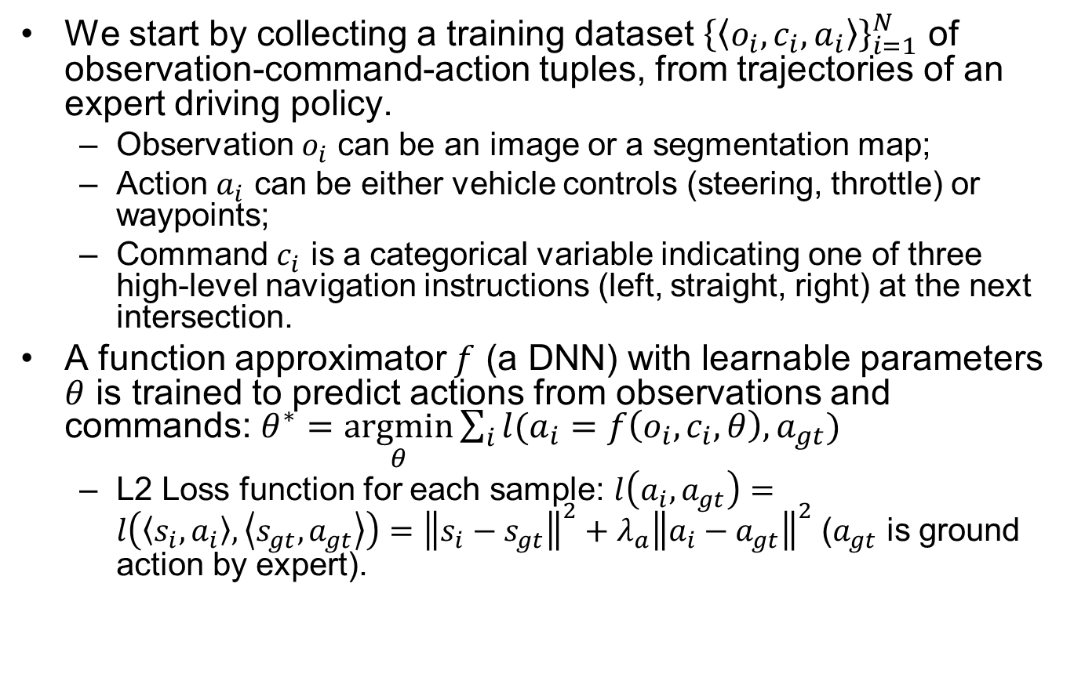
Loss Function for Training Driving Policy
We start by collecting a training dataset ${\left\{\left\langle o_{i},c_{i},a_{i}\right\rangle \right\}}_{i=1}^{N}$ of observation-command-action tuples, from trajectories of an expert driving policy.
Observation $o_{i}$ can be an image or a segmentation map;
Action $a_{i}$ can be either vehicle controls (steering, throttle) or waypoints;
Command $c_{i}$ is a categorical variable indicating one of three high-level navigation instructions (left, straight, right) at the next intersection.
A function approximator $f$ (a DNN) with learnable parameters $θ$ is trained to predict actions from observations and commands: $θ^{∗}=\underset{θ}{argmin}\sum_{i}{l(a_{i}=f\left(o_{i},c_{i},θ\right),a_{gt})}$
L2 Loss function for each sample: $l\left(a_{i},a_{gt}\right)=l\left(\left\langle s_{i},a_{i}\right\rangle ,\left\langle s_{gt},a_{gt}\right\rangle \right)={\left\|s_{i}−s_{gt}\right\|}^{2}+λ_{a}{\left\|a_{i}−a_{gt}\right\|}^{2}$ ($a_{gt}$ is ground action by expert).
Notes:
It is Mean Squared Error (MSE). [Codevilla 2018] then train a DNN $f\left(o_{i},c_{i},θ\right)$ mapping from observations $o_{i}$ and commands $c_{i}$ to actions. with parameters. $θ$ is DNN parameters.
We collect training dataset of observation-command-action tuples from expert driving logs. Given the training dataset,
Observation: segmentation map
Command: one of (left, straight, right) as input
Action: predicted waypoints

Slide 24
The Expert Agent
We program an expert agent to drive autonomously based on privileged information: precise map and location of the ego-vehicle.
A global planner is used to randomly pick routes through a town and produce waypoints along the route. A PID controller is used to follow these waypoints.
In order to increase the diversity of the dataset, the car is randomly initialized within the lane (not always in the center). In total, we record 28 hours of driving. To improve the robustness of the learned policy, we follow [Codevilla 2018] and introduce noise into the controls in approximately 20% of the data.
Notes:
We collect training data in the absence of other agents – vehicles or pedestrians.

Slide 25
Data Augmentation
We performing augmentation on the input images, not the segmentation maps
When training segmentation networks we randomly perturb the input images:
Brightness, Saturation, Hue, Contrast
When training driving policies, we randomly perturb the input images:
Gaussian blur, Additive Gaussian noise, Spatial dropout, Brightness additive, Brightness multiplicative, Contrast multiplicative, Saturation multiplicative…

Slide 26
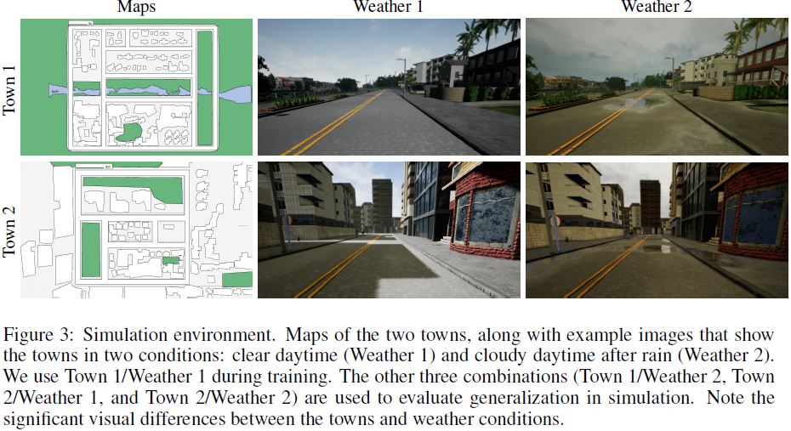
Simulation Environment

Slide 27
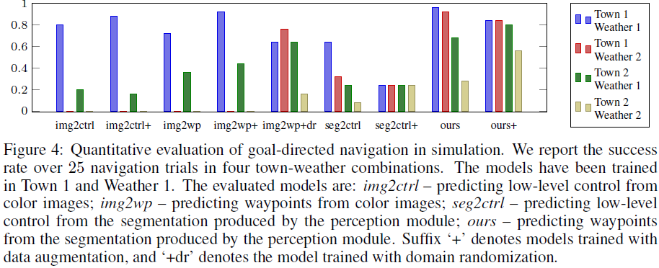
Performance Evaluation
img2ctrl: end-to-end
img2wp: end-to-mid
seg2ctrl: mid-to-end
Ours: mid-to-mid

Slide 28
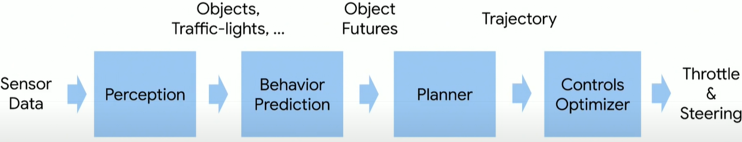
Conditional Affordance Learning (CAL) [Sauer 2018]
Sauer A, Savinov N, Geiger A. Conditional affordance learning for driving in urban environments[J]. arXiv preprint arXiv:1806.06498, 2018. (ETHZ, TU Munich and Max Planck Institute)
No planner. Trajectory is replaced with affordances
End-to-Mid

Slide 29
Abstract
Most existing approaches to autonomous driving fall into one of two categories: modular pipelines, that build an extensive model of the environment, and imitation learning approaches, that map images directly to control outputs. A recently proposed third paradigm, direct perception, aims to combine the advantages of both by using a neural network to learn appropriate low-dimensional intermediate representations. However, existing direct perception approaches are restricted to simple highway situations, lacking the ability to navigate intersections, stop at traffic lights or respect speed limits. In this work, we propose a direct perception approach which maps video input to intermediate representations suitable for autonomous navigation in complex urban environments given high-level directional inputs. Compared to state-of-the-art reinforcement and conditional imitation learning approaches, we achieve an improvement of up to 68% in goal-directed navigation on the challenging CARLA simulation benchmark. In addition, our approach is the first to handle traffic lights and speed signs by using image-level labels only, as well as smooth car-following, resulting in a significant reduction of traffic accidents in simulation.
https://autonomousvision.github.io/conditional-affordance-learning/
Notes:
Conditional Affordance Learning - Talk at CoRL 2018
https://www.youtube.com/watch?v=SceH3Al9w_M

Slide 30
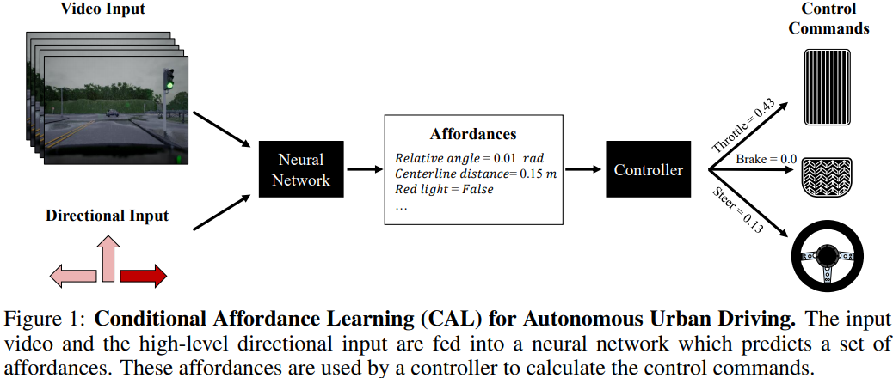
Conditional Affordance Learning (CAL)

Slide 31
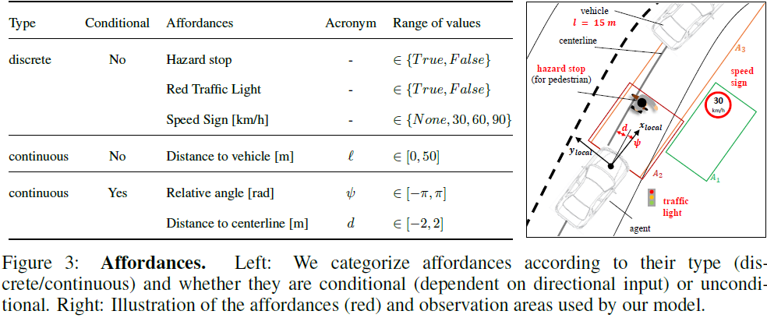
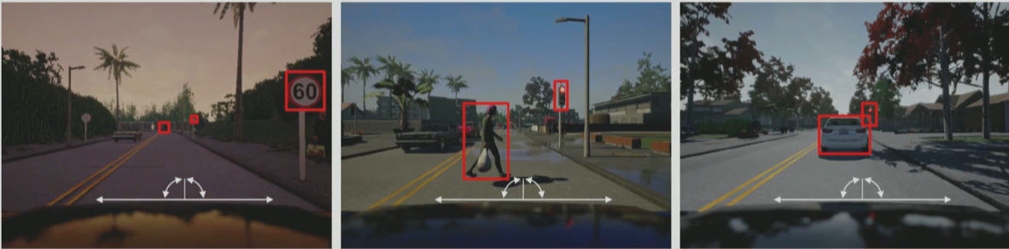
Affordances

Slide 32
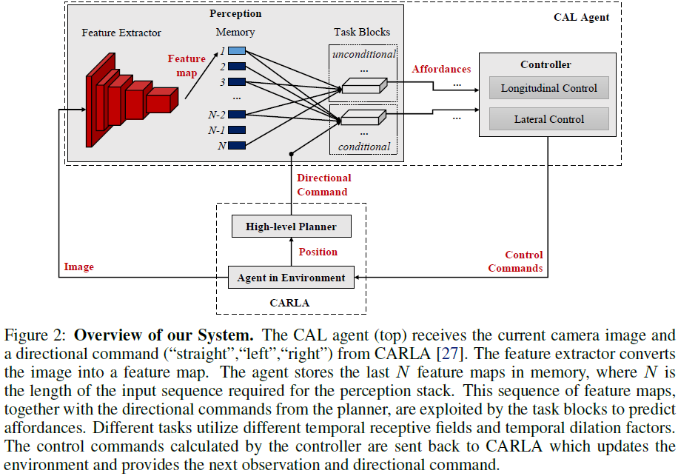

Slide 33
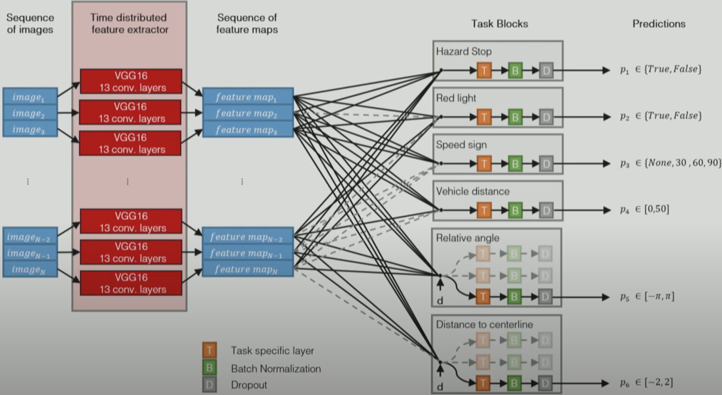
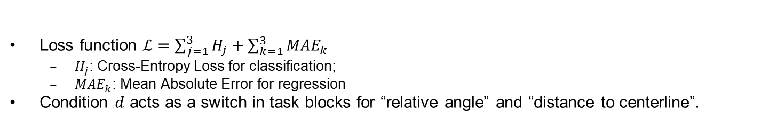
Perception DNN
Loss function $ℒ=\sum_{j=1}^{3}{H_{j}}+\sum_{k=1}^{3}{{MAE}_{k}}$
$H_{j}$: Cross-Entropy Loss for classification;
${MAE}_{k}$: Mean Absolute Error for regression
Condition $d$ acts as a switch in task blocks for “relative angle” and “distance to centerline”.

Slide 34
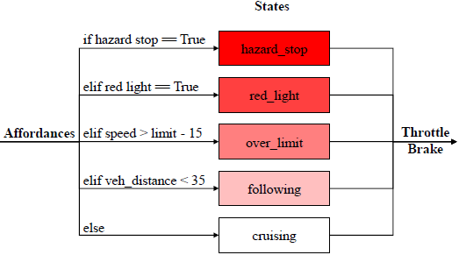
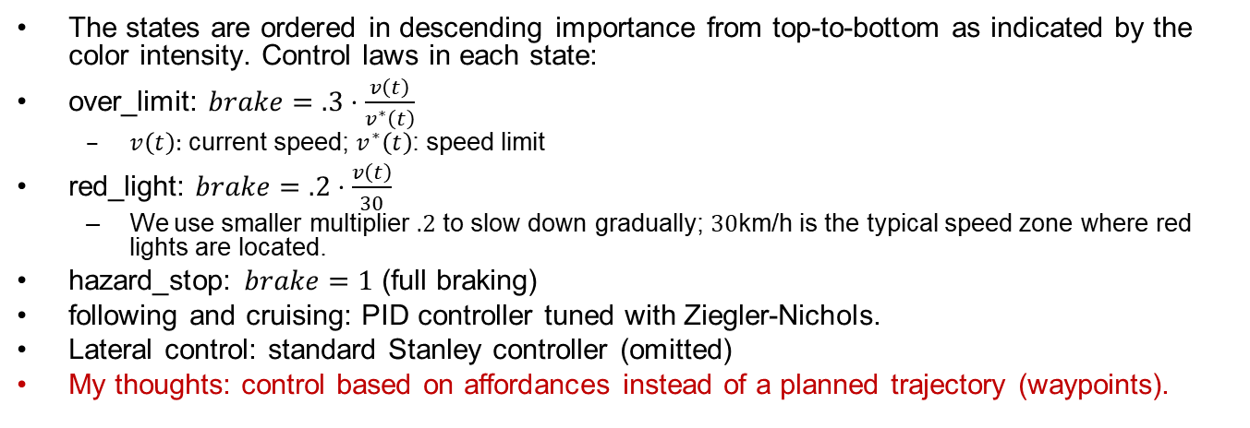
Longitudinal Control
The states are ordered in descending importance from top-to-bottom as indicated by the color intensity. Control laws in each state:
over_limit: $brake=.3⋅\frac{v\left(t\right)}{v^{∗}\left(t\right)}$
$v\left(t\right):$ current speed; $v^{∗}\left(t\right)$: speed limit
red_light: $brake=.2⋅\frac{v\left(t\right)}{30}$
We use smaller multiplier $.2$ to slow down gradually; $30$km/h is the typical speed zone where red lights are located.
hazard_stop: $brake=1$ (full braking)
following and cruising: PID controller tuned with Ziegler-Nichols.
Lateral control: standard Stanley controller (omitted)
My thoughts: control based on affordances instead of a planned trajectory (waypoints).
Notes:
All state are mutually exclusive.

Slide 35
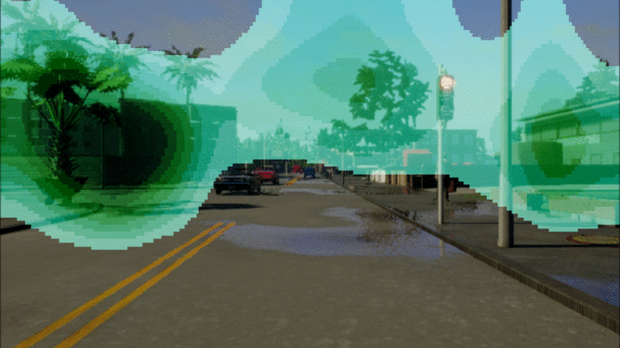
Visualization
We visualized which parts of the image the network attends to when predicting a specific affordance. We found that the network “looks” at the relevant parts of the image similar to what a human would do.
e.g., when looking for a red light it observes the sides, where traffic lights are usually located. (Green color indicates no red light.)
It recognizes crossing pedestrians as obstacles even before they appear in the input image by observing their shadows.
Notes:
Left: The network focuses at the periphery for recognizing traffic
lights. Middle: The network is anticipating a hazard stop by observing the shadow of a pedestrian.
Right: The network focuses its attention on the pedestrian to correctly predict a hazard stop.

Slide 36
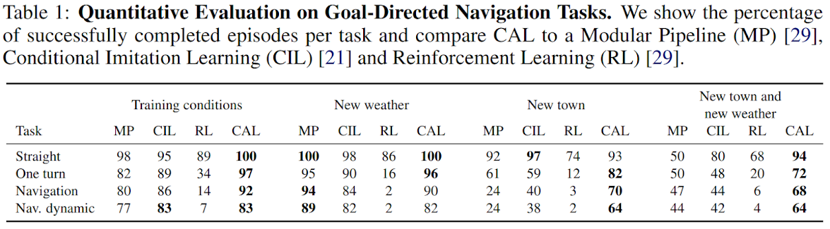
Performance Evaluation
MP: Modular Pipeline
CIL: Conditional IL [Codevilla 2018]
RL: A3C [Mnih 2016]

Slide 37
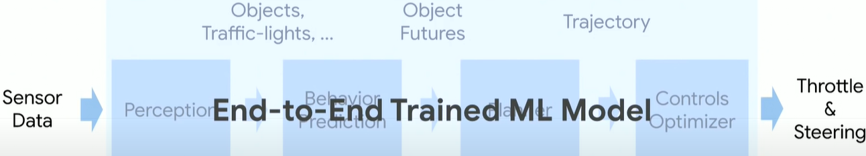
CILRS [Codevilla 2019]
Codevilla F, Santana E, López A M, et al. Exploring the limitations of behavior cloning for autonomous driving[C]//Proceedings of the IEEE International Conference on Computer Vision. 2019: 9329-9338. (U Barcelona, KAUST, Intel Labs)

Slide 38
Abstract
we propose a new benchmark to experimentally investigate the scalability and limitations of behavior cloning. We show that behavior cloning leads to state-of-the-art results, including in unseen environments, executing complex lateral and longitudinal maneuvers without these reactions being explicitly programmed. However, we confirm well-known limitations (due to dataset bias and overfitting), new generalization issues (due to dynamic objects and the lack of a causal model), and training instability requiring further research before behavior cloning can graduate to real-world driving.

Slide 39
Limitations
Bias in Naturalistic Driving Datasets
Most of real-world driving consists in either a few simple behaviors or a heavy tail of complex reactions to rare events.
Causal Confusion
Spurious correlations cannot be distinguished from true causes in observed training demonstration pattern.
The inertia problem: When the ego vehicle is stopped (e.g., at a red traffic light), the probability it stays static is overwhelming in the training data. This creates a spurious correlation between low speed and no acceleration, inducing excessive stopping and difficult restarting in the imitative policy. Although mediated perception approaches that explicitly model causal signals like traffic lights do not suffer from this theoretical limitation, they still under-perform end-to-end learning in unconstrained environments, because not all causes might be modeled (e.g., some potential obstacles) and errors at the perception layer (e.g., missed detections) are irrecoverable.
High variance
With a fixed off-policy training dataset, one would expect CIL to always learn the same policy in different runs of the training phase. However, the cost function is optimized via Stochastic Gradient Descent (SGD), which assumes the data is (i.i.d independent and identically distributed). When training a reactive policy on snapshots of longer human demonstrations included in the training data, the i.i.d. assumption does not hold. Consequently, we might observe a high sensitivity to the initialization and the order in which the samples are seen during training.
Notes:
Consequently, this can result in performance degrading as more data is collected, because the diversity of the dataset does not grow fast enough compared to the main mode of demonstration

Slide 40
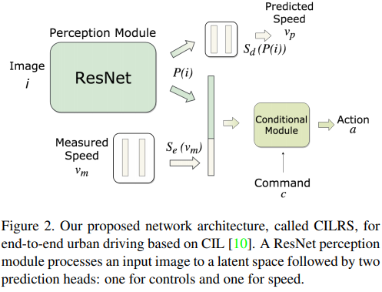
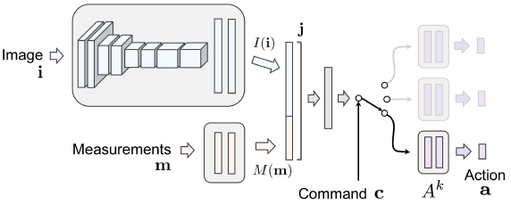
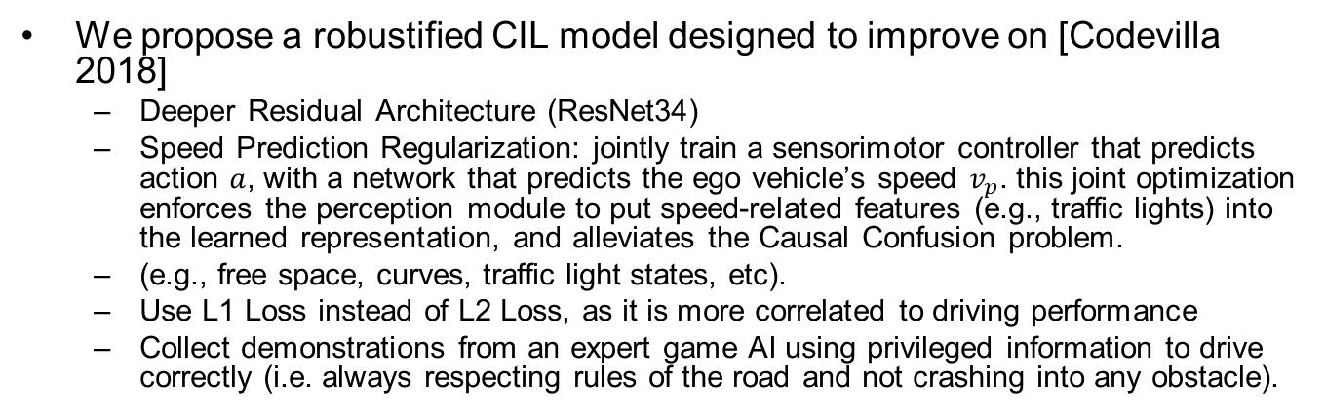
CILRS
We propose a robustified CIL model designed to improve on [Codevilla 2018]
Deeper Residual Architecture (ResNet34)
Speed Prediction Regularization: jointly train a sensorimotor controller that predicts action $a$, with a network that predicts the ego vehicle’s speed $v_{p}$. this joint optimization enforces the perception module to put speed-related features (e.g., traffic lights) into the learned representation, and alleviates the Causal Confusion problem.
(e.g., free space, curves, traffic light states, etc).
Use L1 Loss instead of L2 Loss, as it is more correlated to driving performance
Collect demonstrations from an expert game AI using privileged information to drive correctly (i.e. always respecting rules of the road and not crashing into any obstacle).
Original Network [Codevilla 2018]
Notes:
while remaining off-policy.
[9]. As our NoCrash benchmark consists of complex realistic driving conditions in the presence of dynamic agents, we c
function instead of the mean squared error (MSE)
This reduces the dependency on input speed as the only way to get dynamics of the scene, leveraging instead visual cues (e.g., traffic lights) that are predictive of the car’s velocity

Slide 41
NoCrash Benchmark
More tasks and metrics than the original CARLA benchmark.
We propose three different tasks, each one corresponding to 25 goal directed episodes. In each episode, the agent starts at a random position and is directed by a high-level planner into reaching some goal position. The three tasks have the same set of start and end positions, as well as an increasing level of difficulty:
Empty Town
Regular Traffic
Dense Traffic
We end the episode as failing when any collision bigger than a fixed magnitude happens
Notes:
: moderate number of cars and pedestrians.
large number of pedestrians and heavy traffic (dense urban scenario).

Slide 42
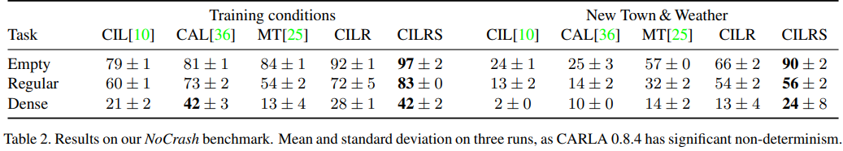
Performance Evaluation
CIL: Conditional IL [Codevilla 2018]
CAL: Conditional Affordance Learning [Sauer 2018]
MT: Multitask [Li 2018] (not discussed)
CILR: CIL with ResNet but no Speed prediction
CILRS: CIL with both ResNet and Speed prediction
Notes:
[10] F. Codevilla, M. Muller, A. L ¨ opez, V. Koltun, and ´ A. Dosovitskiy. End-to-end driving via conditional imitation learning. In International Conference on Robotics and Automation (ICRA), 2018. 1, 2, 3, 4, 5, 6, 12, 13, 14, 15, 16
[36] A. Sauer, N. Savinov, and A. Geiger. Conditional affordance learning for driving in urban environments. arXiv preprint arXiv:1806.06498, 2018. 2, 4, 5, 6, 13
[25] Z. Li, T. Motoyoshi, K. Sasaki, T. Ogata, and S. Sugano. Rethinking self-driving: Multi-task knowledge for better generalization and accident explanation ability. arXiv preprint arXiv:1809.11100, 2018. 2, 5, 6, 13

Slide 43
Learning by Cheating (LBC) [Chen 2019]
Chen D, Zhou B, Koltun V, et al. Learning by cheating[J]. arXiv preprint arXiv:1912.12294, 2019. (UT Austin, Intel Labs)
End-to-Mid

Slide 44
Abstract
Vision-based urban driving is hard. The autonomous system needs to learn to perceive the world and act in it. We show that this challenging learning problem can be simplified by decomposing it into two stages.
We first train an agent that has access to privileged information. This privileged agent cheats by observing the ground-truth layout of the environment and the positions of all traffic participants.
In the second stage, the privileged agent acts as a teacher that trains a purely vision-based sensorimotor agent. The resulting sensorimotor agent does not have access to any privileged information and does not cheat.
This two-stage training procedure is counter-intuitive at first, but has a number of important advantages that we analyze and empirically demonstrate. We use the presented approach to train a vision-based autonomous driving system that substantially outperforms the state of the art on the CARLA benchmark and the recent NoCrash benchmark. Our approach achieves, for the first time, 100% success rate on all tasks in the original CARLA benchmark, sets a new record on the NoCrash benchmark, and reduces the frequency of infractions by an order of magnitude compared to the prior state of the art.
Learning by Cheating
https://www.youtube.com/watch?v=u9ZCxxD-UUw

Slide 45
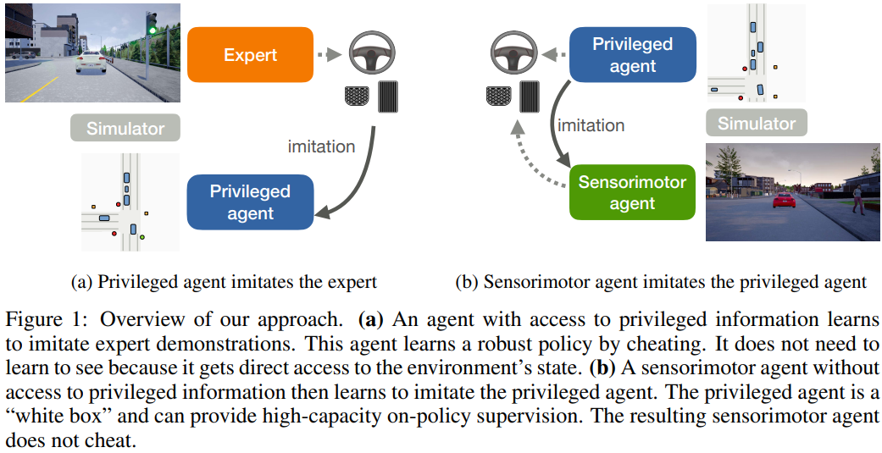
Overview
(a) Privileged agent imitates the expert (Behavior Cloning (off-policy))
(b) Sensorimotor agent imitates the privileged agent (first Behavior Cloning (off-policy), then Direct Policy Learning (on-policy))
Notes:
Training proceeds in two stages. In the first stage, we train the privileged agent from a set of
expert demonstrations. Next, we train the sensorimotor agent off-policy by imitating the privileged
agent on the same set of states as in the first stage, using offline behavior cloning on all commandconditioned
branches. Finally, we train the sensorimotor agent on-policy, using the privileged agent
as an oracle that provides adaptive on-demand supervision in any state reached by the sensorimotor
student [21, 24].
An off-policy learner learns the value of the optimal policy independently of the agent's actions. Q-learning is an off-policy learner. An on-policy learner learns the value of the policy being carried out by the agent including the exploration steps

Slide 46
Why Does it Work?
The effectiveness of this decomposition is counter-intuitive. If direct IL – from expert trajectories to vision-based driving – is hard, why is the decomposition of the learning process into two stages, both of which perform imitation, any better?
First, the privileged agent operates on a compact intermediate representation of the environment, and can thus learn faster and generalize better. In particular, the representation we use (a bird’s-eye view) enables simple and effective data augmentation that facilitates generalization.
Second, the trained privileged agent can provide much stronger supervision than the original expert trajectories. It can be queried from any state of the environment, not only states that were visited in the original trajectories. It turns passive expert trajectories into an online agent that can provide adaptive on-policy supervision.
Third, if the privileged agent is trained via conditional imitation learning, it can provide an action for each possible command (e.g., “turn left”, “turn right”), all at once, in any state of the environment. Thus all conditional branches of the privileged agent can train all branches of the sensorimotor agent in parallel. In every state visited during training, the sensorimotor student can in effect ask the privileged teacher “What would you do if you had to turn left here?”, “What would you do if you had to turn right here?”, etc.
My thoughts: an analogy: expert is a Kung Fu master who lives in the mountains, provides recorded video lectures, but is not available for interactive instructions; privileged agent is a student with perfect eyesight (with bird’s-eye view), hence can learn effectively from the master; sensorimotor agent is a young pupil with poor eyesight (with front-camera view), who can learn more effectively from the junior privileged agent with interactive instructions than from the master directly.
Notes:
The decomposition provides three advantages. This enables automatic DAgger-like training in which supervision from the privileged agent is gathered adaptively via online rollouts of the sensorimotor agent. the privileged agent is a “white box”, in the sense that its internal state can be examined at will. In particular, This is both a powerful form of data augmentation and a high-capacity learning signal.

Slide 47
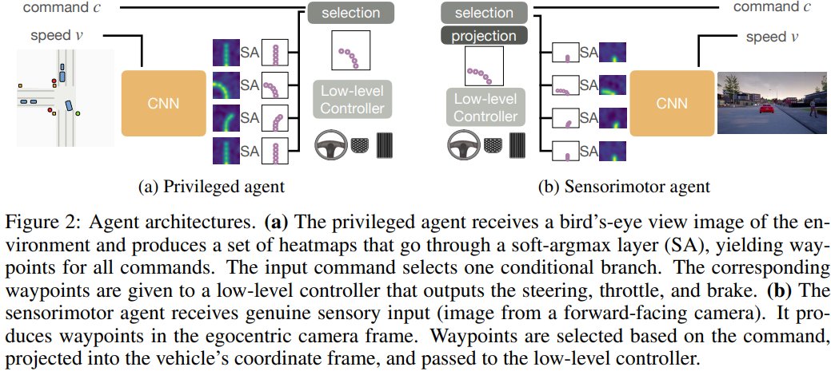
Agent Architecture
steering, throttle, brake

Slide 48
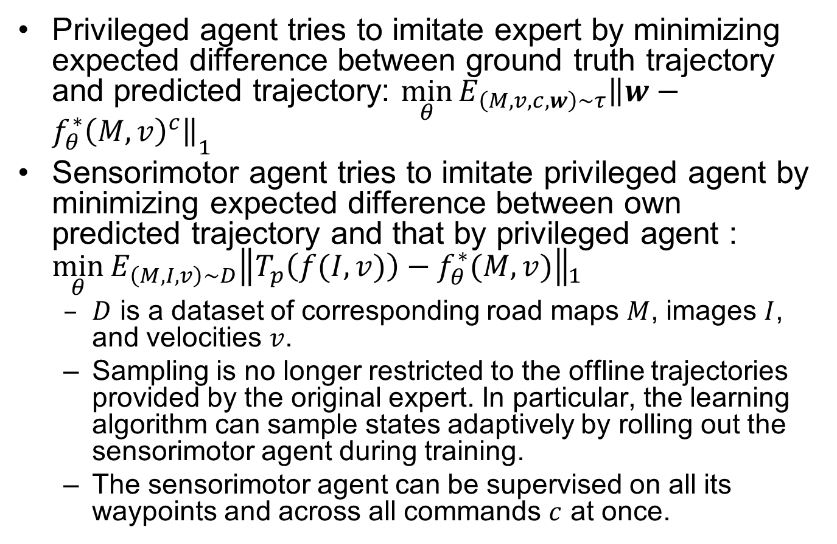
Loss Functins
Privileged agent tries to imitate expert by minimizing expected difference between ground truth trajectory and predicted trajectory: ${\min_{θ}{E_{\left(M,v,c,w\right)∼τ}\left\|w−f_{θ}^{∗}{\left(M,v\right)}^{c}\right\|}}_{1}$
Sensorimotor agent tries to imitate privileged agent by minimizing expected difference between own predicted trajectory and that by privileged agent : ${\min_{θ}{E_{\left(M,I,v\right)∼D}\left\|T_{p}\left(f(I,v)\right)−f_{θ}^{∗}(M,v)\right\|}}_{1}$
$D$ is a dataset of corresponding road maps $M$, images $I$, and velocities $v$.
Sampling is no longer restricted to the offline trajectories provided by the original expert. In particular, the learning algorithm can sample states adaptively by rolling out the sensorimotor agent during training.
The sensorimotor agent can be supervised on all its waypoints and across all commands $c$ at once.
Notes:
Why sensorimotor agent $f_{θ}^{∗}(M,v$) has no c?

Slide 49
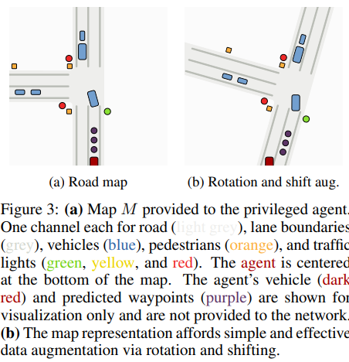
Data Augmentation

Slide 50
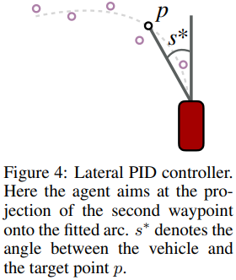
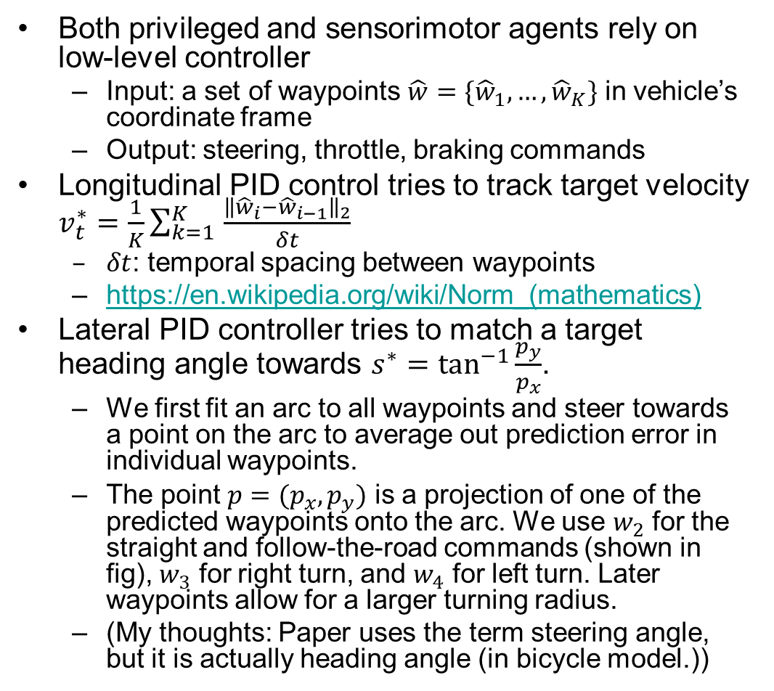
Controller
Both privileged and sensorimotor agents rely on low-level controller
Input: a set of waypoints $\hat{w}=\{{\hat{w}}_{1},…,{\hat{w}}_{K}\}$ in vehicle’s coordinate frame
Output: steering, throttle, braking commands
Longitudinal PID control tries to track target velocity $v_{t}^{∗}=\frac{1}{K}\sum_{k=1 }^{K}{\frac{{\left\|{\hat{w}}_{i}−{\hat{w}}_{i−1}\right\|}_{2}}{δt}}$
$δt$: temporal spacing between waypoints
https://en.wikipedia.org/wiki/Norm_(mathematics)
Lateral PID controller tries to match a target heading angle towards $s^{∗}=\tan^{−1}{\frac{p_{y}}{p_{x}}}$.
We first fit an arc to all waypoints and steer towards a point on the arc to average out prediction error in individual waypoints.
The point $p=(p_{x},p_{y})$ is a projection of one of the predicted waypoints onto the arc. We use $w_{2}$ for the straight and follow-the-road commands (shown in fig), $w_{3}$ for right turn, and $w_{4}$ for left turn. Later waypoints allow for a larger turning radius.
(My thoughts: Paper uses the term steering angle, but it is actually heading angle (in bicycle model.))
Notes:
Specifically, we fit a parametrized circular arc to all waypoints using least-squares fitting. We then steer towards a point p on the arc. The target steering angle is s ∗ = tan−1 (py/px). We use w2 for the straight Two-norm ${\left\|\right\|}_{2}$ is Euclidian distance; one-norm ${\left\|\right\|}_{1}$ is Manhaton distance.

Slide 51
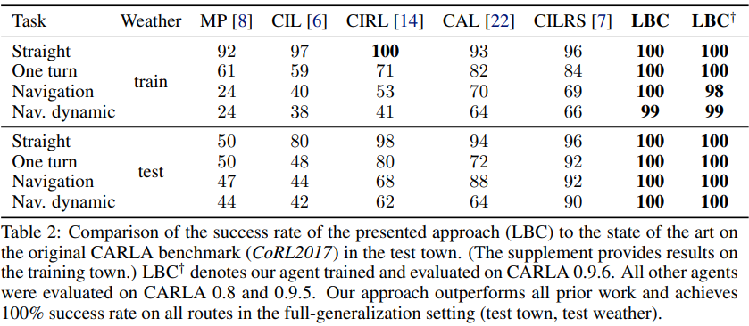
Performance Evaluation
Notes:
[6] F. Codevilla, M. Muller, A. L ¨ opez, V. Koltun, and A. Dosovitskiy. End-to-end driving via ´ conditional imitation learning. In ICRA, 2018. [7] F. Codevilla, E. Santana, A. Lopez, and A. Gaidon. Exploring the limitations of behavior ´ cloning for autonomous driving. In ICCV, 2019. [8] A. Dosovitskiy, G. Ros, F. Codevilla, A. Lopez, and V. Koltun. CARLA: An open urban ´ driving simulator. In CoRL, 2017. [14] X. Liang, T. Wang, L. Yang, and E. Xing. CIRL: Controllable imitative reinforcement learning for vision-based self-driving. In ECCV, 2018. [22] A. Sauer, N. Savinov, and A. Geiger. Conditional affordance learning for driving in urban environments. In CoRL, 2018.

Slide 52
Deep Imitative Models (DIM) [Rhinehart 2020]
Nicholas Rhinehart, Rowan McAllister, Sergey Levine, Deep Imitative Models for Flexible Inference, Planning, and Control, ICLR 2020
Mid-to-Mid

Slide 53
Abstract
Imitation Learning (IL) is an appealing approach to learn desirable autonomous behavior. However, directing IL to achieve arbitrary goals is difficult. In contrast, planning-based algorithms use dynamics models and reward functions to achieve goals. Yet, reward functions that evoke desirable behavior are often difficult to specify. In this paper, we propose “Imitative Models” to combine the benefits of IL and goal-directed planning. Imitative Models are probabilistic predictive models of desirable behavior able to plan interpretable expert-like trajectories to achieve specified goals. We derive families of flexible goal objectives, including constrained goal regions, unconstrained goal sets, and energy-based goals. We show that our method can use these objectives to successfully direct behavior. Our method substantially outperforms six IL approaches and a planning-based approach in a dynamic simulated autonomous driving task, and is efficiently learned from expert demonstrations without online data collection. We also show our approach is robust to poorly specified goals, such as goals on the wrong side of the road.

Slide 54

DIM

Slide 55

DIM Details

Slide 56





Bayes Theorem
$P\left(H | E\right)=\frac{P(E|H)P\left(H\right)}{P\left(E\right)}$
$H$: Hypothesis; $E$: Evidence
3Blue1Brown on Bayes theorem
https://www.youtube.com/watch?v=HZGCoVF3YvM&t=14s
$$P\left(H | E\right)$$
$$P(E|H)$$
$$P\left(H\right)$$
https://www.analyticsvidhya.com/blog/2016/06/bayesian-statistics-beginners-simple-english/

Slide 57

Planning as MAP (Maximum A Posteriori) Inference
$s_{1:T}^{∗}={argmax}_{s_{1:T}}{\log{p(s_{1:T}|𝒢,φ)}}={argmax}_{s_{1:T}}\log{q(s_{1:T}|φ)}+\log{p(𝒢|s_{1:T},φ)}−\log{p\left(𝒢 | φ\right)}={argmax}_{s_{1:T}}\log{q(s_{1:T}|φ)}+\log{p(𝒢|s_{1:T},φ)}$
$s_{t}$: agent state at time $t$ ($t=0$ is current time step; $T$ is planning horizon).
$φ$: all of the agent’s observations.
$q(s_{1:T}|φ)$: learned imitation prior. After training, $q(s_{1:T}|φ)$ can generate trajectories that resemble those that the expert might generate – e.g. trajectories that navigate roads with expert-like maneuvers. However, these maneuvers will not have a specific goal. Beyond generating human-like behaviors, we wish to direct our agent to goals and have the agent automatically reason about the necessary mid-level details. We define general tasks by a set of goal variables $𝒢$.
$p(𝒢|s_{1:T},φ)$: test-time goal likelihood. We give examples of p(Gjs; ) after deriving a maximum a
$p(s_{1:T}|𝒢,φ)$: an expert-like plan that also tries to achieve goals. Probability of a plan $s_{1:T}$ conditioned on the goal G, modelled by a posterior distribution,
Notes:
abstract

Slide 58




Goal Likelihood
Constraint-based planning to goal sets: $p\left(𝒢 | s_{1:T}\right)=δ_{S_{T}}\left(𝒢\right)$ delta function centered around goal (figures below)
$𝒢=\left\{g_{1},g_{2},…,g_{k}\right\}$ Way points (from high-level A* planner)
$𝒢=\left\{{seg}_{1},{seg}_{2},…,{seg}_{k}\right\}$ Line Segments
$𝒢=Polygon$ Region
Unconstrained planning to goal sets: Gaussian distribution instead of delta function
$p\left(𝒢 | s,φ\right)←𝒩(g_{T};s_{T},εT)$ Gaussian Final-State likelihood (reach a single goal state)
$p\left(𝒢 | s,φ\right)←\prod_{k=T−K+1}^{T}{𝒩(g_{k};s_{k},εT)}$ Gaussian State Sequence (reach a sequence of $K$ goal states)
$p\left(𝒢 | s,φ\right)←\frac{1}{K}\prod_{k=1}^{K}{𝒩(g_{T}^{k};s_{T},εT)}$Gaussian Final-State Mixture (reach any one of $K$ goal states)
Goal likelihood encourages goals, rather than dictating them as for constraint-based. Useful for tolerating errors in goal-specification. Hyper-param $ε$ controls variance.
Notes:
What does ; mean XXX

Slide 59


Robustness to Errors in Goal-Specification.
To test model’s capability to stay in the distribution of demonstrated expert behavior, we designed a “decoy waypoints” experiment.
Navigating with high-variance waypoints.
Half of the waypoints are highly perturbed versions of the other half, serving as distractions for our Gaussian Final-State Mixture imitative planner.
Navigating with waypoints on the wrong side of the road.
The planned path still stays on the road to mimic the expert behavior, rather than following the goals blindly, thanks to the learned imitation prior $q(s_{1:T}|φ)$, which outweighs the influence of bad goals $p\left(𝒢 | s_{1:T},φ\right)$ when computing $s_{1:T}^{∗}$, if $p\left(𝒢 | s,φ\right)$ has high variance (with large $ε$).
Notes:
We observed surprising robustness to decoy
waypoints.

Slide 60


Slide 61


Slide 62
Summary
We proposed “Imitative Models” to combine the benefits of IL and MBRL. Imitative Models are probabilistic predictive models able to plan interpretable expert-like trajectories to achieve new goals.
Inference with an Imitative Model resembles trajectory optimization in MBRL, enabling it to both incorporate new goals and plan to them at test-time, which IL cannot.
Learning an Imitative Model resembles offline IL, enabling it to circumvent the difficult reward-engineering and costly online data collection necessities of MBRL.
ICLR 2020 Talk:
https://iclr.cc/virtual_2020/poster_Skl4mRNYDr.html

Slide 63
Hierarchical IL and IL/RL [Le 2018]
Le, Hoang M., et al. "Hierarchical imitation and reinforcement learning." arXiv preprint arXiv:1803.00590 (2018). (Caltech)
https://sites.google.com/view/hierarchical-il-rl

Slide 64
Abstract
We study how to effectively leverage expert feedback to learn sequential decision-making policies. We focus on problems with sparse rewards and long time horizons, which typically pose significant challenges in reinforcement learning. We propose an algorithmic framework, called hierarchical guidance, that leverages the hierarchical structure of the underlying problem to integrate different modes of expert interaction. Our framework can incorporate different combinations of imitation learning (IL) and reinforcement learning (RL) at different levels, leading to dramatic reductions in both expert effort and cost of exploration. Using long-horizon benchmarks, including Montezuma’s Revenge, we demonstrate that our approach can learn significantly faster than hierarchical RL, and be significantly more label-efficient than standard IL. We also theoretically analyze labeling cost for certain instantiations of our framework.

Slide 65

Montezuma’s Revenge
Challenge: rewards are too sparse, player has to make many moves before receiving any reward.
Positive rewards: picking up the key (reward of 100), using the key to open the door (reward of 300). Optimal execution of this sequence of actions requires more than 200 primitive actions.
Several standard RL approaches failed to get any reward.
Notes:
Standard flat RL algorithms often achieve a score of 0 on this domain.

Slide 66
IL to the Rescue?
IL shortcuts exploration by observing and imitating expert
A limitation of existing IL approaches is that they may require a large amount of demonstration data in long-horizon problems. But expert labels may be costly (effort, money…)
Question addressed: when experts are available, how can we leverage their labels/feedback effectively?

Slide 67
Contributions
Hierarchical IL
Teacher provides high-level feedback and zooms into low-level only when needed
Savings in teaching effort, speedup in learning
Hybrid IL/RL
Teacher provides only high-level feedback, and agent applies RL on low-level
Speed-up in learning

Slide 68

Maze Navigation Task
In each episode, the agent encounters a new instance of the maze from a large collection of different layouts. Each maze consists of 16 rooms arranged in a 4-by-4 grid, but the openings between the rooms vary from instance to instance as does the initial position of the agent and the target. The agent (white dot) needs to navigate from one corner of the maze to the target marked in yellow. Red cells are obstacles (lava, not walls!), which the agent needs to avoid for survival.
Due to a large number of random environment instances, this domain is not solvable with tabular algorithms.
Notes:
We have multiple random instances of the environment. The agent (white dot) is supposed to navigate to the destination in the yellow block, while avoiding all the obstacles (red)

Slide 69


Standard (Flat) IL
Problem setup:
States: pixel representation of top-level view
Actions: up/down/left/right
Policy: state $→$ action
IL algorithm:
Repeatedly:
Agent acts according to current policy
If goal not reached:
Expert labels each step with correct action (yellow arrows)
Agent updates policy
Expert labeling effort proportional to task horizon (~50).

Slide 70



Hierarchical Policy
Problem setup:
States, actions same as before
5 macro-actions: go to door up, door down, door left, door right, target.
Hierarchical policy:
Meta-controller: state $→$ macro-action
For each macro-action:
Subpolicy: state $→$ action or “stop”

Slide 71

Not covered in exam
Hierarchical Agent

Slide 72

Hierarchical IL
Expert labels high-level trajectory with correct macro-actions.
More selective labeling on low-level:
If a good subpolicy accomplishes a correct macro-action, expert checks correctness, no need to label.
If a bad subpolicy fails a correct macro-action, expert labels the corresponding low-level trajectory.
Notes:
Theorem: labeling effort = high-level horizon + low-level horizon (mus)
Expert labels the low-level trajectory if subpolicy fails a correct macro-action
Expert finds the first mistake, and if it is due to I

Slide 73

Hybrid IL/RL
High-level: IL (DAgger)
Expert labels high-level trajectory with correct macro-actions.
Low-level: RL (DDQN with prioritized experience replay)
As long as macro-actions are correct, pass the low-level trajectories to subpolicy RL learner.
e.g., it is much easier for RL agent to learn to go to “door down” than go to final goal.
Notes:
hg-DAgger/Q; Dagger as high-level IL, DDQN with prioritized experience replay as low-level RL algo.

Slide 74
Reduced Expert Labeling Effort
Human experts are effective at
Providing high-level labels
e.g., to go home, go straight for 4 blocks, turn left, go straight for 2 blocks, then turn right.
Instead of low-level commands for steering/acceleration/braking
Verifying if a macro-action is completed successfully by the low-level trajectory, compared to labeling the low-level trajectory for that macro-action.
Notes:
Verify if high-level macro-action is completed successfully, than
provide preference a,og

Slide 75

Hiearchical IL for Maze Navigation
Algorithm performance is measured by success rate, defined as the average rate of successful task completion over the previous 100 test episodes, on random environment instances not used for training.
Notes:
The cost of each Label operation equals the length of the labeled trajectory, and the cost of each Inspect operation equals 1.

Slide 76

Hybrid IL/RL for Montezuma’s Revenge
Figure 3 (left) displays the environment and an annotated sequence of 4 subgoals: go to bottom of the right stair, get the key, reverse path to go back to the right stair, then go to open the door (while avoiding obstacles throughout).
Subgoal 4 (door) is the most difficult to learn due to its long horizon whereas subgoals 1–3 are mastered very quickly, especially compared to h-DQN.
In addition to external rewards, agent is given a pseudo-reward of 1 for each subgoal completion and -1 upon loss of life.

Slide 77
Summary
Two hierarchical guidance frameworks
Hierarchical IL requires much fewer labels than flat IL
When low-level horizon is short, hybrid IL/RL works well even when hierarchical IL fails.
High-level labels help ensure that low-level labeling and learning occurs only in relevant part of the state space.

